Slide 1


Quantum Computing: The Future of Computing
Quantum computing represents a revolutionary shift in how we approach information processing and problem-solving. By harnessing the strange and powerful principles of quantum mechanics, quantum computers have the potential to unlock new frontiers in fields ranging from cryptography to drug discovery. This presentation will explore the fundamental concepts of quantum computing, its remarkable algorithms, and the transformative applications that are poised to reshape our world.
by Siri Voore
22071A6764 CSE – DS – A

Slide 2

Introduction to Quantum Computing
Qubit: The Quantum Bit
Quantum Mechanics
Unlike classical bits that can only exist in states of 0 or 1, qubits can exist in a superposition of these states, allowing them to represent and process information in entirely new ways.
Quantum computing is based on the principles of quantum mechanics, which describe the behavior of particles at the smallest scales of the universe. These principles, such as superposition and entanglement, are the key to the computational power of quantum systems.
Quantum Algorithms
Quantum algorithms are designed to take advantage of the unique properties of quantum mechanics, allowing them to solve certain problems exponentially faster than classical algorithms.

Slide 3
The Principles of Quantum Mechanics
Superposition
Entanglement
Uncertainty Principle
In the quantum world, particles can exist in a superposition of multiple states simultaneously, rather than being limited to a single, definitive state as in classical physics.
Quantum particles can become entangled, where the state of one particle is inextricably linked to the state of another, regardless of the distance between them.
The Heisenberg Uncertainty Principle states that the more precisely the position of a particle is determined, the less precisely its momentum can be known, and vice versa.

Slide 4
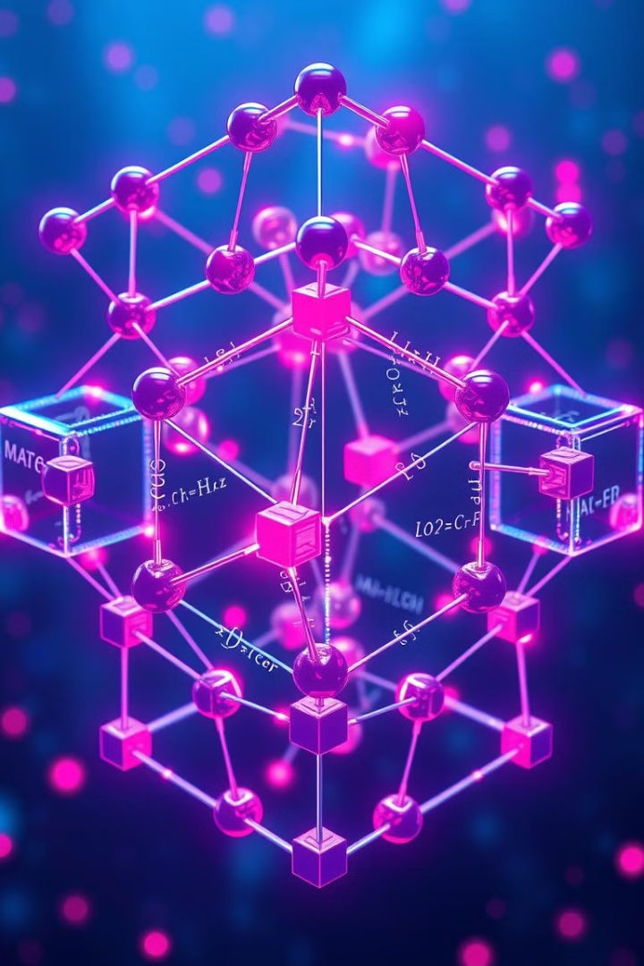
Quantum Algorithms and Their Advantages
1
Shor's Algorithm
Shor's algorithm is a quantum algorithm that can efficiently factorize large numbers, a task that is believed to be intractable for classical computers. This has significant implications for cryptography and data security.
2
Grover's Algorithm
Grover's algorithm is a quantum algorithm that can search an unstructured database quadratically faster than classical algorithms, with important applications in areas like database search and optimization problems.
3
Quantum Simulation
Quantum computers can simulate the behavior of quantum systems with unprecedented accuracy, enabling breakthroughs in fields like materials science, chemistry, and drug discovery.

Slide 5

Applications of Quantum Computing: Drug Discovery and Chemistry
1
Molecular Modeling
2
Chemical Reactions
3
Material Design
Quantum computers can simulate the complex interactions and structures of molecules with unparalleled precision, accelerating the discovery of new drugs and materials.
Quantum simulations can accurately model the dynamics of chemical reactions, enabling the optimization of industrial processes and the development of more efficient catalysts.
Quantum computing can help scientists design new materials with tailored properties, such as superconductors, energy storage devices, and advanced composites.

Slide 6




Applications of Quantum Computing: Financial Modeling
Portfolio Optimization
Risk Analysis
Fraud Detection
Quantum algorithms can solve complex portfolio optimization problems exponentially faster than classical methods, enabling more efficient investment strategies.
Quantum computing can provide more accurate risk assessments by simulating complex financial models and scenarios, leading to better risk management and decision-making.
Quantum algorithms can detect patterns and anomalies in large financial datasets faster, improving the identification and prevention of fraudulent activities.

Slide 7




Applications of Quantum Computing: Artificial Intelligence and Machine Learning
Data Processing
Algorithm Optimization
Quantum Machine Learning
Quantum computers can process large, complex datasets more efficiently, accelerating the training of machine learning models and the extraction of insights from big data.
Quantum algorithms can optimize the performance of classical machine learning algorithms, leading to faster convergence and more accurate predictions.
Entirely new quantum-based machine learning algorithms are being developed, which have the potential to solve problems that are intractable for classical computers.

Slide 8

Applications of Quantum Computing: Climate Modeling
Weather Prediction
Quantum computing can simulate complex weather and climate patterns with greater accuracy, leading to improved weather forecasting and disaster preparedness.
Carbon Capture
Quantum simulations can help design more efficient carbon capture and sequestration technologies, contributing to the fight against climate change.
Energy Optimization
Quantum algorithms can optimize energy production and distribution systems, enabling the integration of renewable energy sources and improving grid efficiency.

Slide 9
Challenges and Limitations in Quantum Computing
Hardware Challenges
Scalability Issues
Algorithmic Limitations
Building and maintaining stable, error-free quantum systems is extremely challenging due to the delicate nature of quantum states and the need for precise control over the environment.
As the number of qubits in a quantum computer increases, the complexity of controlling and maintaining the system also grows exponentially, posing significant scaling challenges.
While quantum algorithms can provide exponential speedups for certain problems, many real-world problems may not see significant benefits from quantum computing, at least in the near future.

Slide 10

The Future of Quantum Computing
Quantum computing represents a profound transformation in the world of information technology, promising to unlock unprecedented computational power and redefine the boundaries of what's possible. As we stand on the cusp of a quantum revolution, the future of this transformative technology holds the key to solving some of humanity's most complex challenges, from cryptography and drug discovery to climate modeling and beyond.

Slide 11

Conclusion: Quantum Computing's Transformative Promise
1
Quantum Supremacy
2
Advancing Scientific Discovery
Achieving quantum supremacy, the point where quantum computers outperform classical computers on specific tasks, is a significant milestone that has already been reached by leading tech giants and research institutions.
Quantum computing's ability to simulate complex quantum systems will accelerate scientific breakthroughs, leading to advancements in fields like materials science, chemistry, and climate modeling.
3
Revolutionizing Industries
4
Quantum Internet and Quantum Sensing
The disruptive potential of quantum computing will transform industries ranging from finance and logistics to cryptography and cybersecurity, unlocking unprecedented efficiencies and competitive advantages.
The development of quantum internet and quantum sensing technologies will further expand the applications of quantum computing, enabling secure communication and precise measurement capabilities.

Slide 12

Thank You

